Slide 1


CLAUDE CODE MASTERCLASS

Slide 2
CLAUDE CODE QUICK STARTUP

Slide 3

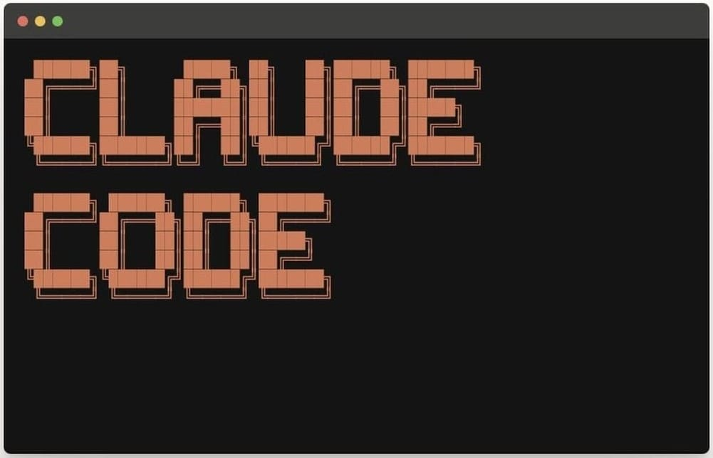



Intro to Claude Code
Claude Code is an agentic AI coding tool that reads your codebase, edits files, runs commands, and autonomously works through problems.
It’s available in the terminal, VS Code, Antigravity, and the Claude Desktop app. We will focus on running Claude Code inside of VS Code.
© All rights reserved for Dr. Ryan Ahmed @Stemplicity Inc.
Runs Commands
Plans & Reasons
Reads & Writes Code
Executes shell commands, runs tests, manages Git, and builds projects
Breaks down complex tasks, proposes solutions, and iterates on feedback
Analyzes your entire codebase, makes targeted edits, and creates new files

Slide 4




Claude Code Agentic Workflow
Claude Code follows a four-phase cycle for every task
1
2
3
4
Explore
Plan
Implement
Commit
© All rights reserved for Dr. Ryan Ahmed @Stemplicity Inc.
Read files, understand the codebase
Design the implementation approach
Write code, run tests, iterate
Commit changes, create Pull request (PRs)

Slide 5
Claude Plan Mode
Read-only analysis before making changes. Toggle with Shift+Tab.
>>>
Normal Mode
Claude reads, writes, and runs commands
>>
Auto-Accept
Like normal, but skips permission prompts
© All rights reserved for Dr. Ryan Ahmed @Stemplicity Inc.
||
Plan Mode
Read-only: Claude explores but never edits
When to Use Plan Mode
When to Skip It
Multi-file changes where scope is unclear
Exploring unfamiliar codebases safely
Fix is obvious (typo, rename, log line)
Scope is clear and well-defined

Slide 6
Installation and Quick Demo of Claude Code
Show basic commands: /model, /status
Show Normal mode vs. plan mode vs. accept edits on
© All rights reserved for Dr. Ryan Ahmed @Stemplicity Inc.

Slide 7
PROJECT 1: BUILD A BUSINESS LANDING PAGE WITH NO SKILLS (PART A)

Slide 8
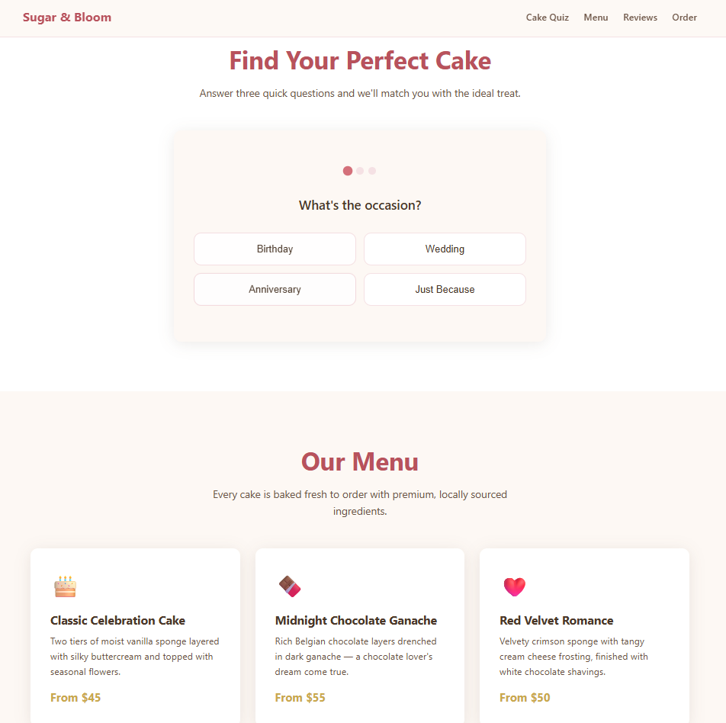
Project overview
Using Claude Code, we will build a single-page website for "Sugar & Bloom" bakery; featuring a hero intro, interactive step-by-step cake quiz, menu with 6 cakes, customer reviews, and a contact/order form, all in one HTML file.
A baseline build without any skills, so we can later compare the raw output against a skill-enhanced version to see how much design quality and polish the frontend-design skill adds.
© All rights reserved for Dr. Ryan Ahmed @Stemplicity Inc.

Slide 9
Project overview
1
2
3
Build Raw
One prompt → full landing page
Install Skill
Add the frontend- design skill
Rebuild
Same prompt → stunning upgrade
© All rights reserved for Dr. Ryan Ahmed @Stemplicity Inc.

Slide 10
SKILLS

Slide 11
What is a skill?
A skill is a folder with a SKILL.md file; it gives Claude a detailed playbook and loads it automatically when the task is relevant.
How it loads
What's inside
Where it lives
Claude reads the SKILL.md at the start of a task; automatically or when you call it with a slash command like /frontend-design
Instructions, best practices, templates, and optional scripts that Claude follows to complete the task correctly every time
In .claude/skills/ for a project, or ~/.claude/skills/ for personal use across all projects.
© All rights reserved for Dr. Ryan Ahmed @Stemplicity Inc.

Slide 12
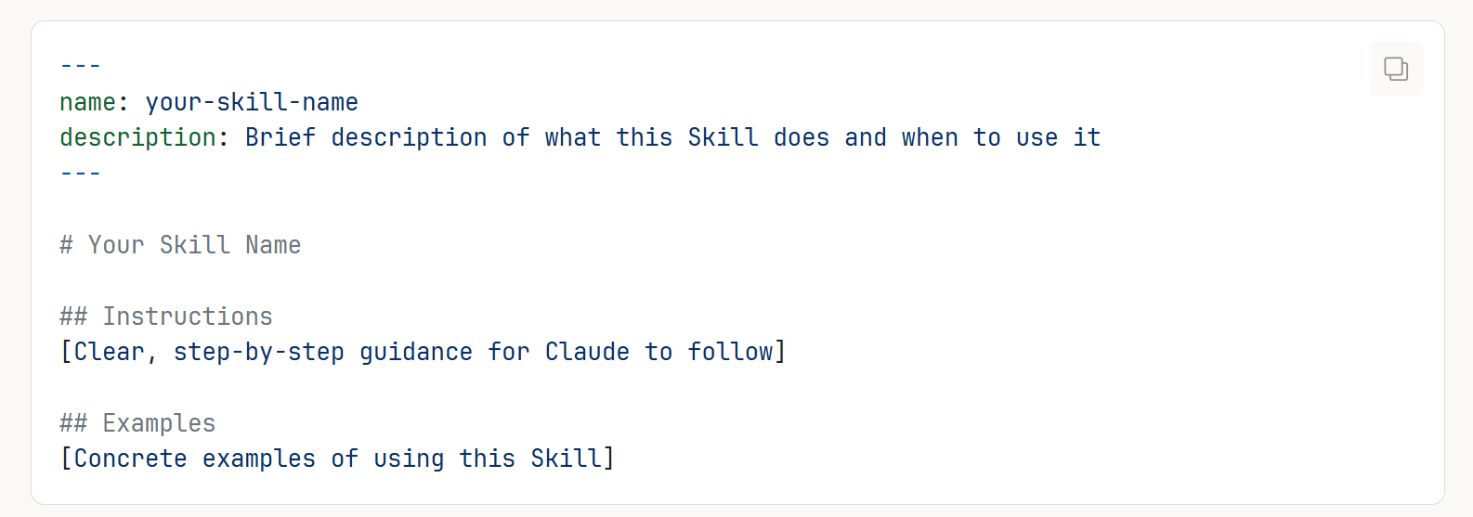
What does a Skill file look like?
Skills extend Claude's capabilities by giving it access to specialized knowledge and workflows. Create once, use everywhere.
Claude loads skills dynamically to improve performance on specialized tasks.
Every Skill requires a SKILL.md file.
Note that on the top of each SKILL.md file, there is metadata that describes what the skill does which includes name and description.
© All rights reserved for Dr. Ryan Ahmed @Stemplicity Inc.

Slide 13
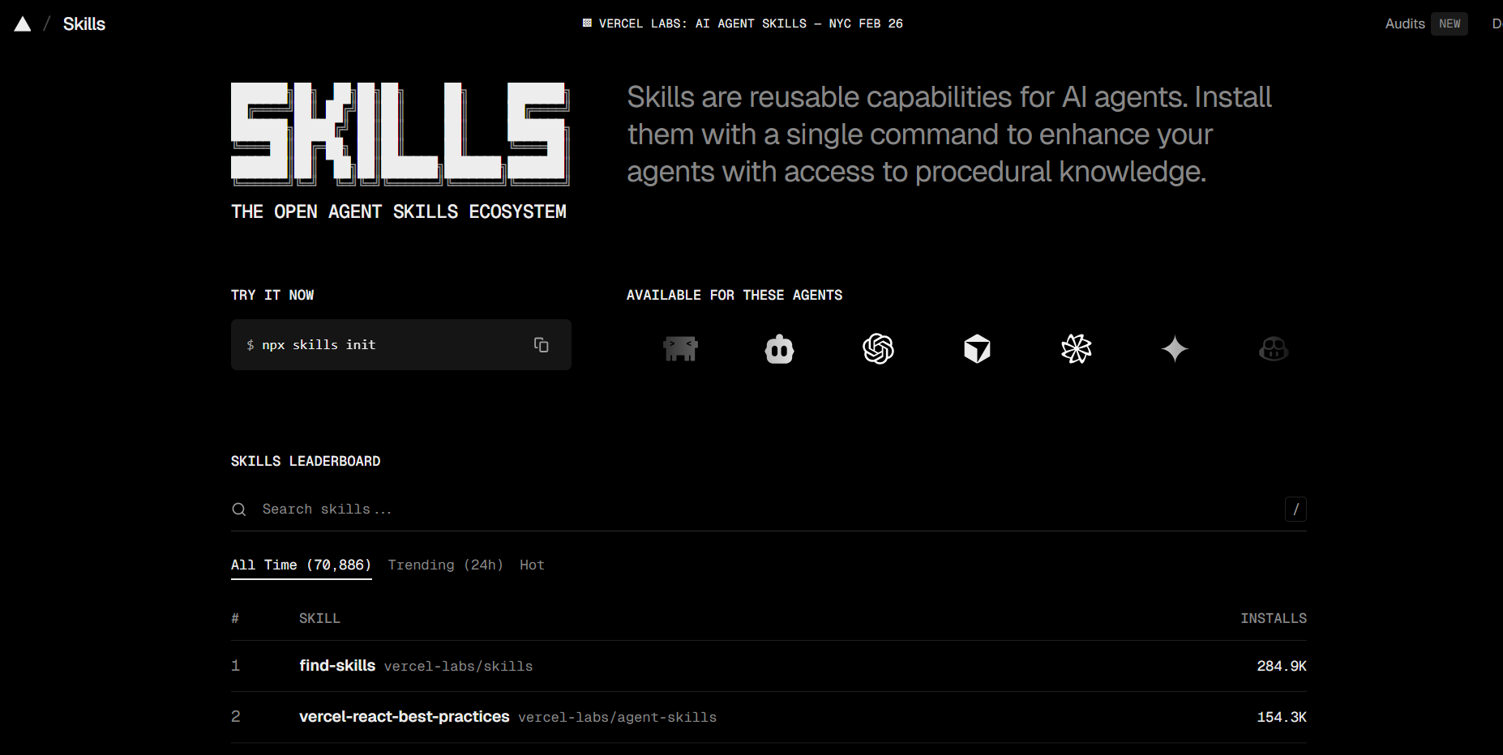
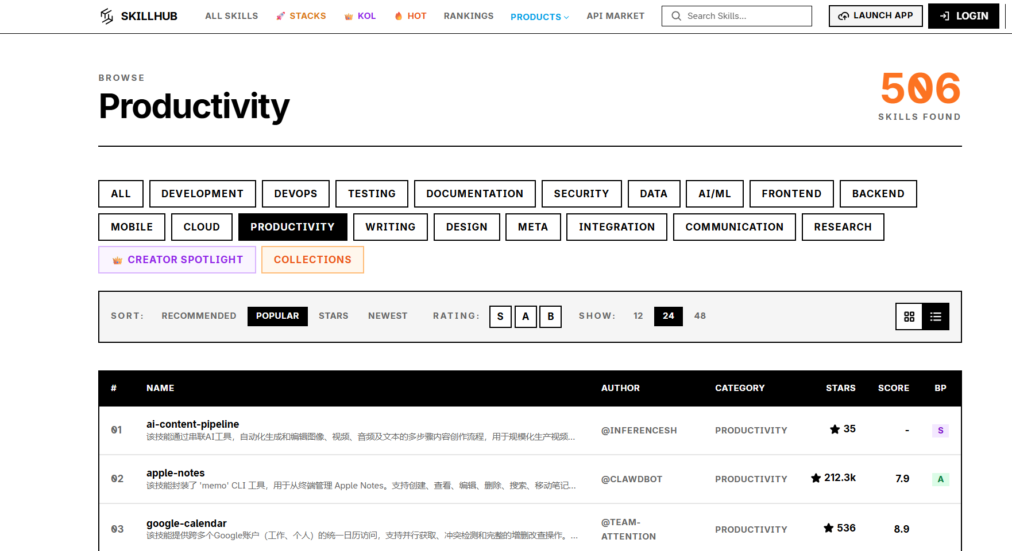
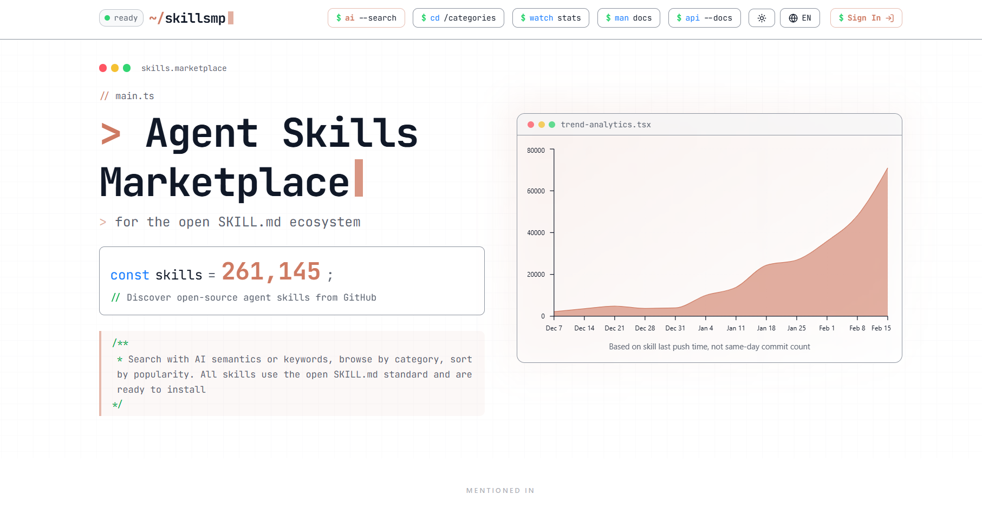
Skills Sources
https://skills.sh/
https://www.skillhub.club/
© All rights reserved for Dr. Ryan Ahmed @Stemplicity Inc.
https://skillsmp.com/

Slide 14
Anthropic’s Official Skills
Check the official skills list: https://github.com/anthropics/skills/tree/main/skills
pptx
PowerPoint
xlsx
Excel
docx
Word
Create and edit .pptx presentations
Build spreadsheets, charts, and formulas
Generate and edit formatted .docx documents
© All rights reserved for Dr. Ryan Ahmed @Stemplicity Inc.
pdf
PDF
frontend-design
Create, fill, merge, and extract from PDFs
Production-grade UI with bold aesthetic choices

Slide 15
Example: frontend-design skill
What it does
SKILL.md (simplified)
Loads before Claude writes any UI code
Gives Claude a design philosophy; bold aesthetic choices, distinctive fonts, purposeful color palettes
Prevents the generic 'AI-generated' look
Enforces production-grade output; not just functional, but visually refined
Auto-triggers when you ask to build any web UI, dashboard, or component
---
name: frontend-design
description: Create distinctive,
production-grade UI. Use when
building web components,
dashboards, or any web UI.
---
Before writing code, commit to
© All rights reserved for Dr. Ryan Ahmed @Stemplicity Inc.
a BOLD aesthetic direction:
- Pick a tone: minimal, luxury,
editorial, brutalist...
- Choose distinctive fonts
- Use purposeful color palettes
- Add meaningful animations
- Make it UNFORGETTABLE
Install: npx skills add anthropics/claude-code --skill frontend-design

Slide 16
PROJECT 1: INSTALL FRONT-END DESIGN SKILL (PART B)

Slide 17
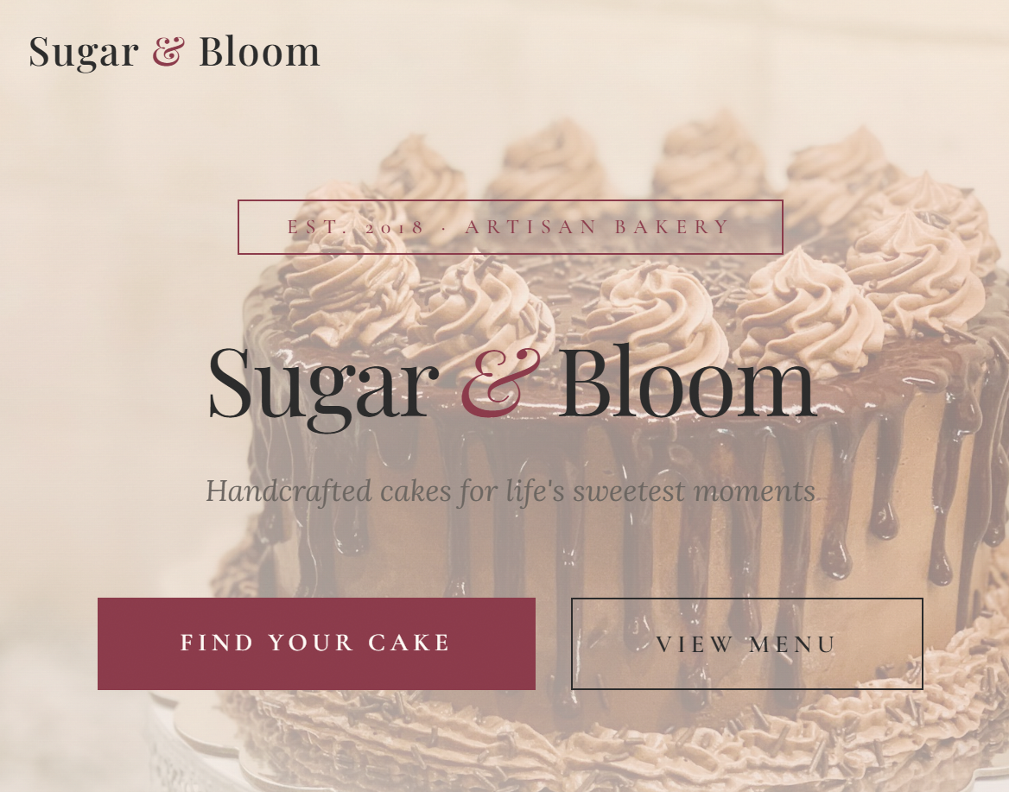
Project overview
Using Claude Code, we will build a single-page website for "Sugar & Bloom" bakery with the frontend design skill.
© All rights reserved for Dr. Ryan Ahmed @Stemplicity Inc.

Slide 18
Before and After Using Skills
Using the same prompt but with the frontend-design skill leads to a radically different result.
npx skills add anthropics/claude-code --skill frontend-design
Without Skill
Default fonts (Arial, system fonts)
Muted, safe color palette
Predictable card layouts
Minimal animations
It works... but looks generic
With frontend-design Skill
Bold, intentional typography pairings
Distinctive color palette with accents
Professional layout with visual hierarchy
Purposeful animations and micro-interactions
Looks like a designer built it
© All rights reserved for Dr. Ryan Ahmed @Stemplicity Inc.

Slide 19
PRACTICE OPPORTUNITY

Slide 20

Practice Opportunity
Build a landing page for a boutique pet grooming salon that includes:
A hero section with the name "Mindful Paws" and tagline "Where grooming meets calm“
An interactive booking quiz: Pet type (Dog/Cat/Other) → Size (Small/Medium/Large) → Service (Bath & Brush, Full Groom, Spa Day) → shows a price estimate
A services section with 4 services, each with a description and price
A gallery section with image placeholders of happy pets
A booking form with pet name, owner name, phone, and preferred date
The Challenge:
Build it raw: no skill, just one prompt. Save as `[business_name].html
Rebuild with skill: same prompt, frontend-design skill active. Save as `[business_name]_v2.html`
Compare: open both side by side. What changed? Write your own Claude Code prompt following the CIIO format (Context, Instruction, Input, Output).
© All rights reserved for Dr. Ryan Ahmed @Stemplicity Inc.

Slide 21
SLASH COMMANDS

Slide 22
Use Claude Built-in Slash Commands
A slash command is a shortcut that starts with / to quickly trigger an action in Claude Code.
It helps you work faster by giving structured instructions to Claude. Instead of typing a long request, the slash command immediately tells the AI what kind of operation you want.
Type / in Claude Code to see all available commands. These are built-in slash commands. The real power is creating your own commands.
/help See all available commands and skills
/usage Check your token usage and spending
/model Switch between AI models (faster vs smarter)
/compact Summarize conversation to free up context
© All rights reserved for Dr. Ryan Ahmed @Stemplicity Inc.
/diff Review all file changes Claude just made
/status Check your account, model, and connection
/skills List all installed skills
/init Create a CLAUDE.md project guide
/context shows Claude context window utilization

Slide 23
Slash Commands Demo in Claude Code
© All rights reserved for Dr. Ryan Ahmed @Stemplicity Inc.

Slide 24
PROJECT 2: GENERATE BRANDED ASSETS WITH SLASH COMMANDS

Slide 25
Project 2: Create a slash command for your brand
Instead of explaining your brand Every Single Time. We can create a slash command that includes all our details.
"Use a warm tone but keep it professional"
"My brand colors are #D4786A and #2C3E50"
"Don't say 'utilize' or 'leverage'
© All rights reserved for Dr. Ryan Ahmed @Stemplicity Inc.
Without Brand Command
"Write me an email" leads to a generic tone
Every output sounds different
With /my-brand Command
"Write me an email" will use your voice and your colours.
Every output is consistently on-brand

Slide 26
Create /my-brand
Your brand kit in one file
Brand Identity
Name, tagline, mission statement
Colors
Primary #1A1A2E • Secondary #E8D5B7 • Accent #C9A96E
File Location:
~/.claude/commands/my-brand.md
Available in every project you open
Typography
Cormorant Garamond headings + Nunito Sans body
© All rights reserved for Dr. Ryan Ahmed @Stemplicity Inc.
Tone of Voice
Calm, artistic, confident
Vocabulary
Use: timeless, craft, story | Avoid: cheap, snap, basic

Slide 27
Sample created Command file
My-brand.md
# Kai Lens Studio — Brand Identity
Apply this brand identity to everything you create in this conversation. Every piece of content — emails, social posts, web pages, documents, UI copy — must reflect these guidelines without exception.
## Business
- **Name:** Kai Lens Studio
- **Tagline:** "Your story, beautifully told"
## Visual Identity
### Colors
| Role | Name | Hex |
|------|------|-----|
| Headings, backgrounds | Deep Navy | `#1A1A2E` |
| Accents, highlights | Warm Sand | `#E8D5B7` |
| Buttons, links | Antique Gold | `#C9A96E` |
### Typography
- **Headings:** Cormorant Garamond
- **Body text:** Nunito Sans
When generating HTML, CSS, or UI code, always reference these fonts (via Google Fonts or equivalent) and apply colors using the hex values above.
## Tone of Voice
Write like a photographer who sees beauty in everything and speaks with quiet authority — calm, artistic, and confident. Never rushed. Never salesy. Every sentence should feel considered and unhurried.
- Speak to clients as creative collaborators, not customers
- Favor evocative, sensory language over transactional language
- Let the work speak; don't oversell
## Vocabulary
### Words we use `timeless` · `craft` · `story` · `light` · `moment` · `authentic` · `intentional`
### Words we never use ~~cheap~~ · ~~package~~ · ~~deal~~ · ~~basic~~ · ~~quick~~ · ~~selfie~~ · ~~snap~~
## Closing Phrases
Rotate naturally among these sign-offs:
- "Let's tell your story."
- "See you through the lens."
## Applying This Brand
Every time you generate content for Kai Lens Studio:
1. **Visual output** (HTML, CSS, components) → use brand colors and fonts exactly
2. **Written output** (emails, captions, copy, bios) → match tone, use preferred vocabulary, end with a closing phrase
3. **Structural output** (docs, proposals) → lead with the tagline or brand name where appropriate, maintain the calm/confident voice throughout
4. **Never** produce content that contradicts this identity — if a request conflicts with the brand, adapt it so it fits while still fulfilling the intent
This command activates the full brand context. Proceed with whatever task follows.
© All rights reserved for Dr. Ryan Ahmed @Stemplicity Inc.

Slide 28
Use Your Brand Command
Everything Claude creates now follows your brand automatically
One file. Every output, on-brand. Forever.
Branded Email
You ask:
"Write a follow-up email for Priya & James
after their engagement photoshoot"
Claude delivers:
✔ Calm, artistic tone (your brand voice)
✔ Uses words like 'timeless' and 'light'
✔ Signs off with your closing phrase
Branded Social Post
You ask:
"Write an Instagram caption for a behind-
the-scenes wedding photo"
Claude delivers:
✔ Warm, artistic caption (not salesy)
✔ Avoids banned words (cheap, snap, basic)
✔ Includes relevant hashtags
© All rights reserved for Dr. Ryan Ahmed @Stemplicity Inc.

Slide 29
Key Takeaways
Slash commands = reusable workflows
Create once, use forever across every project and conversation
Brand identity lives in one file
© All rights reserved for Dr. Ryan Ahmed @Stemplicity Inc.
Colors, fonts, tone, vocabulary all in ~/.claude/commands/my-brand.md
Every output stays consistent
Emails, posts, pages, reports; Claude automatically follows your brand

Slide 30
Create a slash Command Demo in Claude Code
© All rights reserved for Dr. Ryan Ahmed @Stemplicity Inc.

Slide 31
PRACTICE OPPORTUNITY

Slide 32
Practice Opportunity
Create a slash command called /my-brand-verde-k for a business named “Verde Kitchen”, a plant-based meal prep service. The brand colours are Forest Green, Cream, and Terracotta. Details:
Business: Verde Kitchen
Tagline: "Eat well. Live well. No effort required.“
Colors: Forest Green (#2D5A27), Cream (#FAF3E0), Terracotta (#C4704F) Fonts: Josefin Sans for headings, Source Sans Pro for body*
Tone: Friendly, encouraging, health-conscious like a supportive friend who also happens to be a chef
Words to use: nourish, fresh, plant-powered, simple, wholesome, vibrant* Words to avoid: diet, restrict, guilty, cheat meal, processed, artificial
2. Test the command by generating a marketing email and a flyer
3. Do both outputs feel like they come from the same brand voice and visual identity?
© All rights reserved for Dr. Ryan Ahmed @Stemplicity Inc.

Slide 33
PLUGINS

Slide 34
Plugins
A plugin is a bundled package; it wraps skills, MCP servers, agents, and hooks into a single installable unit that works across all your projects.
Skills Vs. Plugins:
A skill teaches Claude how to do one thing. A plugin bundles multiple skills (and more) into a shareable package for your whole team.
A plugin can contain:
© All rights reserved for Dr. Ryan Ahmed @Stemplicity Inc.
Skills
MCP servers
Agents
Hooks
Playbooks that auto-trigger
External tool connections
Specialized sub-agents
Auto-run on events

Slide 35





Plugins
Plugins bundle skills, connectors, slash commands & sub-agents into one package for a specific job function. No technical knowledge required to create them.
What's Inside a Plugin
Pre-Built Plugins
Skills: Specialized knowledge & workflows
HR: People operations & lifecycle
Connectors (MCP): Link to Google Drive, Slack, etc.
Design: UX, accessibility, critiques
© All rights reserved for Dr. Ryan Ahmed @Stemplicity Inc.
Engineering: Standups, deploys, incidents
Slash Commands: Quick-launch structured workflows
Operations: Runbooks, vendor evals
Sub-Agents: Specialized task executors
Finance: FP&A, variance analysis
Sales: Outreach, research, CRM

Slide 36
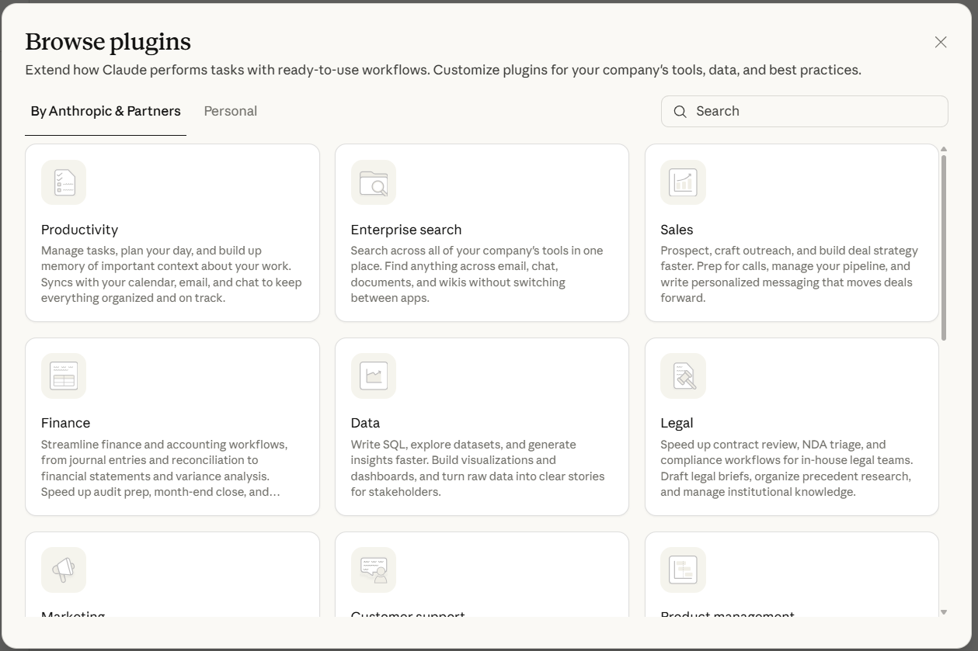
Available Claude Cowork Plugins
© All rights reserved for Dr. Ryan Ahmed @Stemplicity Inc.

Slide 37
Popular Plugins
Anthropic official
Community
Community
Ralph Wiggum
context7
feature-dev
Self-driving dev agent for long autonomous coding sessions. Loops through tasks, commits to git, and resets context between tasks.
Pulls live, version-specific library docs into your session. Stops Claude hallucinating API calls from outdated training data.
Turns a feature brief into working code. Structured planning → spec → implementation. 89,000+ installs.
Anthropic official
Anthropic official
Community
code-review
playwright
© All rights reserved for Dr. Ryan Ahmed @Stemplicity Inc.
superpowers
Adds /code-review command. Reviews changed files for quality, security, and test coverage before you commit.
It navigates URLs, fills forms, takes screenshots, and runs end-to-end tests; no scripting required.
Planning, debugging, and code review all in one. Structured lifecycle for building features from scratch.
Anthropic official
marketing
Build performance reports, run SEO audits, and design email sequences with /performance-report, /seo-audit, /email-sequence.

Slide 38
PROJECT 3: COMPETITIVE ANALYSIS & MARKETING STRATEGY WITH CLAUDE PLUGINS

Slide 39
What You’ll Build
Business: Pulse & Flow Studio, Austin TX where "Strength meets stillness"
1
2
3
Install
Add Playwright + Marketing plugin
Screenshots
Browse competitor sites, take screenshots using Playwright Plugin
Strategy
Generate a full marketing action plan using the marketing plugin
© All rights reserved for Dr. Ryan Ahmed @Stemplicity Inc.

Slide 40
Step 1: Install Playwright + Marketing Plugin
Playwright: Browser Automation
Install (inside Claude Code):
/plugin install playwright@claude-plugins-official
Claude can now: Open browsers, navigate sites,
click elements, take screenshots, read pages
Anthropic Marketing Plugin
Install:
/plugin marketplace add anthropics/knowledge-work-plugins
/plugin install marketing@knowledge-work-plugins
Claude gets: Content strategy, competitive analysis,
campaign planning, brand positioning frameworks
© All rights reserved for Dr. Ryan Ahmed @Stemplicity Inc.
Both installed via /plugin; no MCP config, no API keys, no subscriptions

Slide 41
Step 2: Competitive Analysis with Playwright
Claude browses competitor sites in real time
Competitors Analyzed:
• barrys.com (high-energy HIIT)
• purebarre.com (barre fitness)
© All rights reserved for Dr. Ryan Ahmed @Stemplicity Inc.
Visit Site
Navigate to each competitor’s homepage
Screenshot
Full-page capture of key pages
Analyze
Note messaging, colors, CTAs, vibe

Slide 42
Step 3: Generate a Marketing Strategy
Playwright gathered the data and Marketing plugin turned it into strategy
Brand Positioning How to differentiate from competitors
Content Calendar 4 weeks of Instagram + LinkedIn posts
Landing Page Fixes 7 improvements based on competitor analysis
© All rights reserved for Dr. Ryan Ahmed @Stemplicity Inc.
Customer Acquisition 5 creative ideas competitors aren’t using
Quick Wins 3 things to implement THIS WEEK

Slide 43
Practice Opportunity
Run a competitive analysis using Playwright + the marketing plugin for a new artisan coffee roastery.
Business: Ember & Origin: “Single-origin, small-batch, roasted with intention.” Audience: Coffee enthusiasts who value origin, process, and sustainability.
Competitors
https://bluebottlecoffee.com
https://www.stumptowncoffee.com
https://counterculturecoffee.com
Tasks:
1. Capture Screenshots (Playwright), For each competitor, screenshot the Homepage, One key page (Products, Pricing, or About)
2. Analyze: Compare competitors on Brand positioning, Messaging, Product differentiation, Sustainability claims, Website UX/design, Gaps or missed opportunities
3. Strategy for Ember & Origin (Marketing Plugin) Generate 5 differentiation strategies, 4-week content calendar (social, email, blog), Focus on origin transparency, craft roasting, and sustainability.
© All rights reserved for Dr. Ryan Ahmed @Stemplicity Inc.

Slide 44
Thank you!

